Slide 1
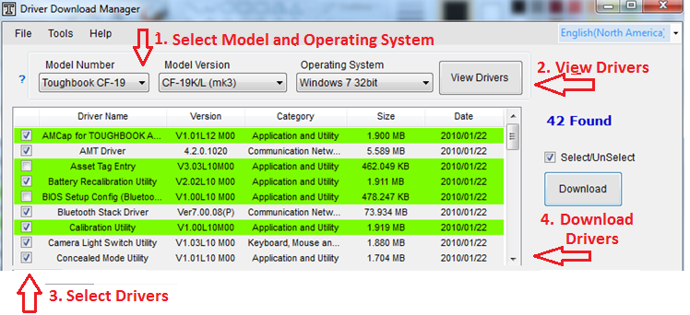
Driver Download Manager
SIMPLE and easy UI
Download Drivers for Panasonic Toughbook Models
4 Easy steps

Slide 2
Powerful Features
Select individual or multiple drivers in one step
Provides One-click download for multiple drivers
Unpacks and stages drivers for Deployment
Multi-platform functionality throughout all OS systems
Notifies the users for any updates
Option to only download latest drivers
Set the concurrent number of driver downloads
Specify target download directory
Creates separate directories based on models
Software support ticket capability

Slide 3
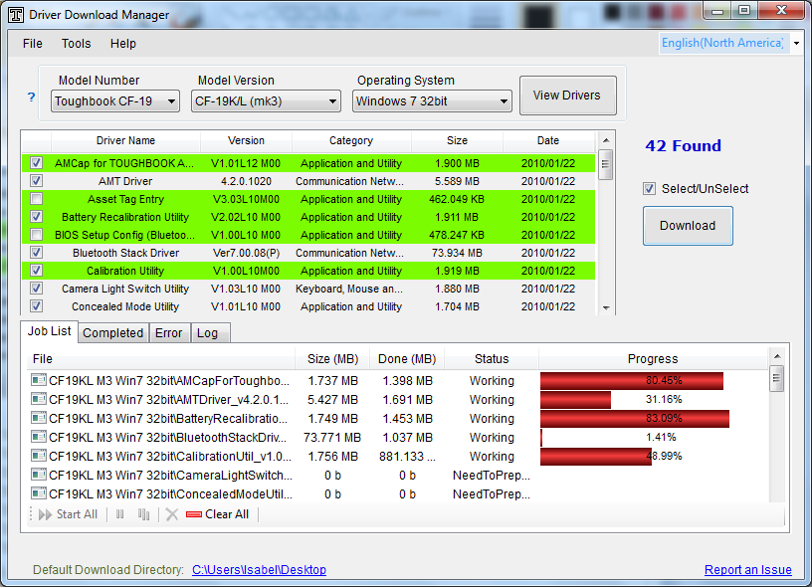
Download For Free from Panasonic Website:
http://www.panasonic.com/business/toughbook/computer-support-search-downloads.asp

